Slide 1
Cloth Movement Demo
Onur Kulaksizoglu

Slide 2
Progress Report Plan
Do a basic stretched Cube/Polyhedra Demo (a 3D spring like object)
I already have a lot of 3D rendering code from the rigid dynamics HW3
Main Goal -> Do a simple cloth demo (a flat fabric instead of a dress)
Extras if I have enough time:
Collide multiple deformable polyhedra?
Move some calculations to GPU, and measure performance gains

Slide 3
Final Plan
Do a basic stretched Cube/Polyhedra Demo (a 3D spring like object)
I already have a lot of 3D rendering code from the rigid dynamics HW3
Main Goal -> Do a simple cloth demo (a flat fabric instead of a dress)
Extras if I have enough time:
Collide multiple deformable polyhedra?
Move some calculations to GPU, and measure performance gains

Slide 4
Final Plan / Broadly what I did
Do a basic stretched Cube/Polyhedra Demo (a 3D spring like object)
Turns out it’s unrelated to cloth task, requires tetrahedron constraints
Main Goal -> Do a simple cloth demo (a flat fabric instead of a dress)
Extras if I have enough time:
Bugs took up too much time: C++ Eigen lib api is unintuitive
Was solving for LL^{T}LL^{T}x=b for the whole time! (LL^{T} Cholesky form)
Paper is not clear about some details, e.g. unknown matrix sizes, is it 3x3 or NxN??

Slide 5
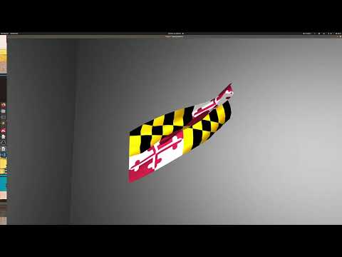
Demo

Slide 6
Details - Features
Real time~ simulation, 30 FPS
But with only 200 triangles (very small)
Not scalable, quadratic~ with # of triangles
Requires further optimization
Parallel Projective Dynamic algorithm
With area preserving triangle constraints
+ fixed points (flag pole)
OpenMP
Non-interactive rendering, could create better scenes

Slide 7
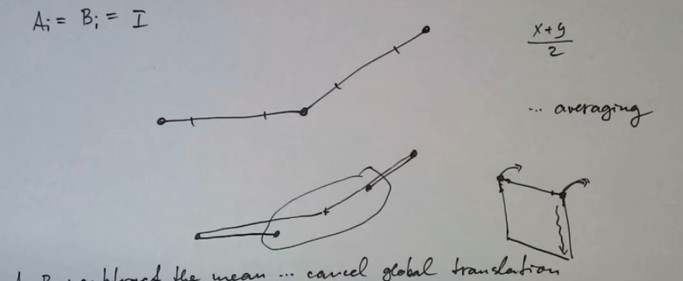
Projective Dynamics - Short Explanation of the Method
Do until convergence:
Local Step: Projection
Global Step: Dynamics, System Solve

Slide 8
Impression about Projective Dynamics
Advantages:
Allows parallelization and precomputation
Local Step is parallel and Global Step is precomputed
It is very simple
Disadvantages:
Non realistic
Instead of the “force” from the spring we have a “position constraint”
Adding gravity broke my simulation
Constant forces accumulate very fast and make system unstable
It is too simple
Requires human attention
Constraints must be properly weighted, just giving 1 to everything doesn’t work
E.g. flag pole constraint has a weight of 100, triangles have 1.

Slide 9
Demo

